Slide 1
Final Project
IST 722
Avery Curcio
Gabe Herz
Hongdi Li
Nien Tzu Shih

Slide 2
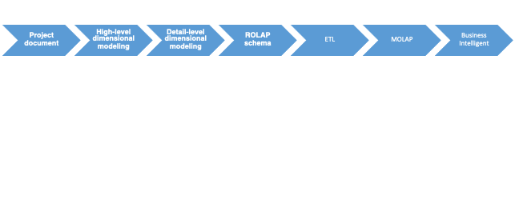
Our Project/Goals
Business Requirements
Analyze sales in FudgeFlix and FudgeMart
Goals:
See which products earn the most revenue for the merged Fudge Company
See which geographical areas generate the most revenue
See which products are most costly
See what times of year lead to increased/decreased revenue/costs

Slide 3
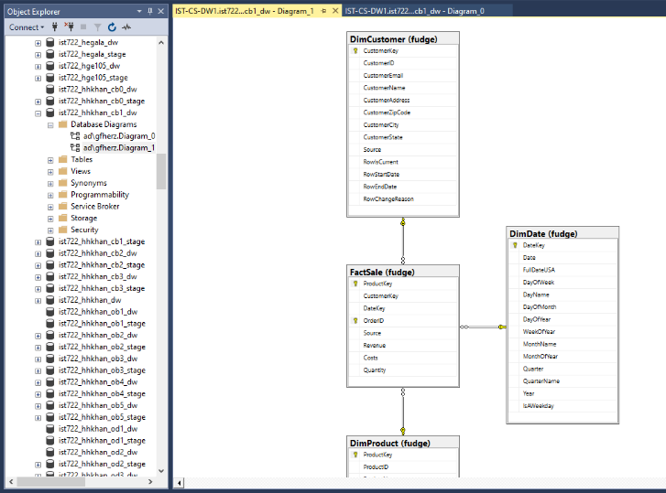
Star Schema (Data Warehouse)
Merged Fudgeflix & Fudgemart into one

Slide 4
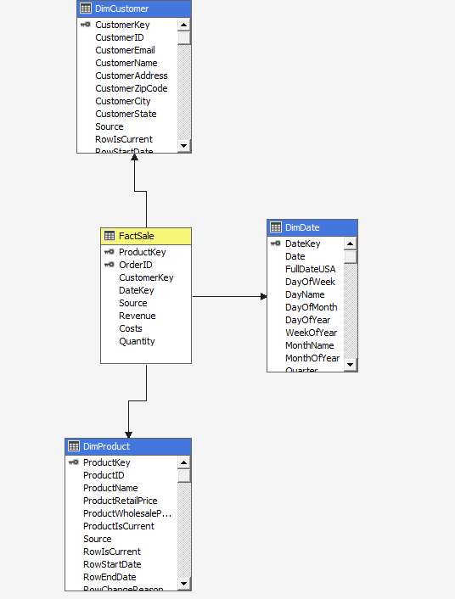
Star Schema (Cube)
Create cube from the join data

Slide 5
Merged Data Assumptions
The Measures in our Fact Table were Revenue ( Retail Price / Amount Billed * Quantity) and Costs (Wholesale Price * Quantity)
FudgeFlix sells plans as a product so there is no data on wholesale price or explicit value for quantity ordered.
We made the assumption that wholesale price, or cost, for each FudgeFlix product was $2
We also made the assumption that the quantity ordered for each FudgeFlix transaction was $1.
Data Summary:
In the merged Product Dimension, there were 60 total products
53 from FudgeMart and 7 from FudgeFlix
In the merged Customer Dimension, there were 60 total Customers
25 from FudgeMart and 35 from FudgeFlix
In the merged FactSale table, there were 11,760 documented sales
10,466 sales from FudgeMart and 1,294 from FudgeFlix
Notes:
Gabe

Slide 6
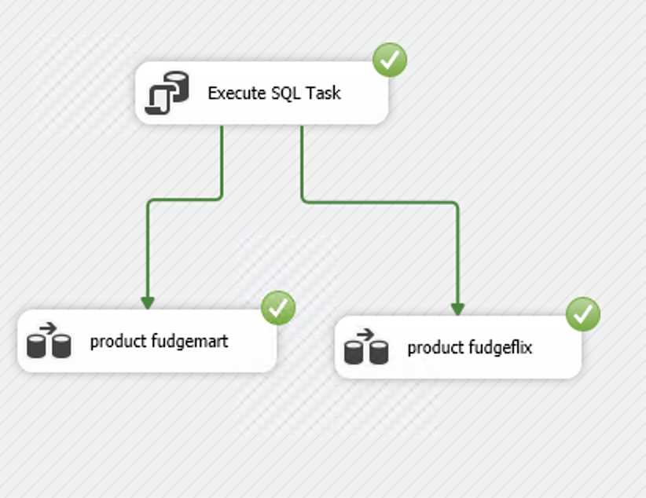
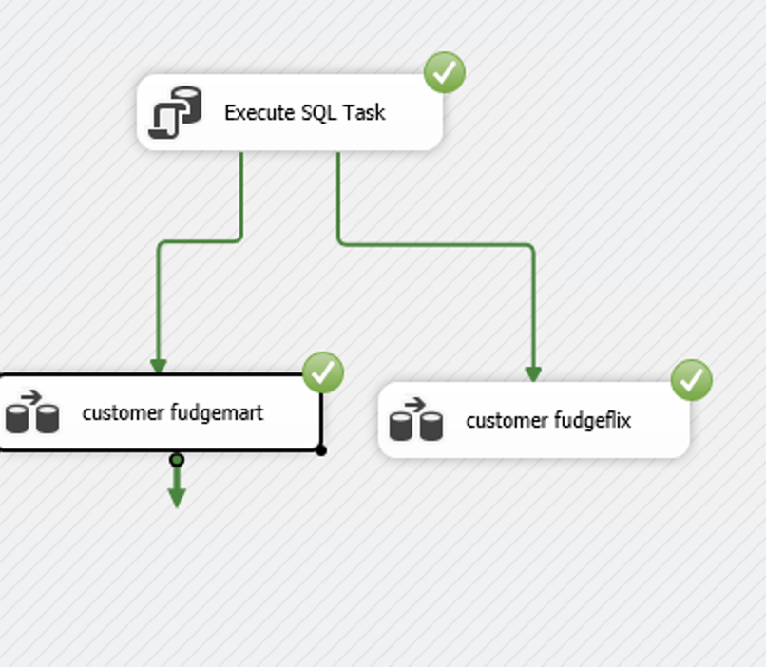
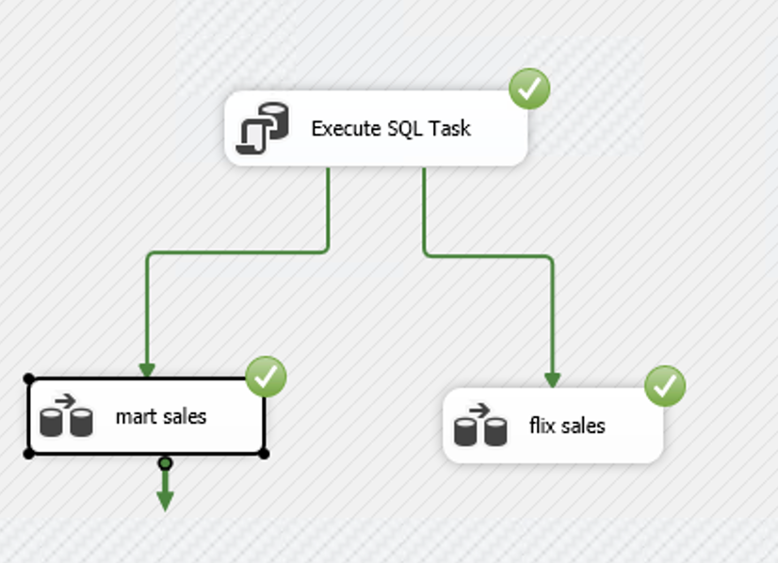
ETL - Source to Stage Table
Notes:
Gabe

Slide 7
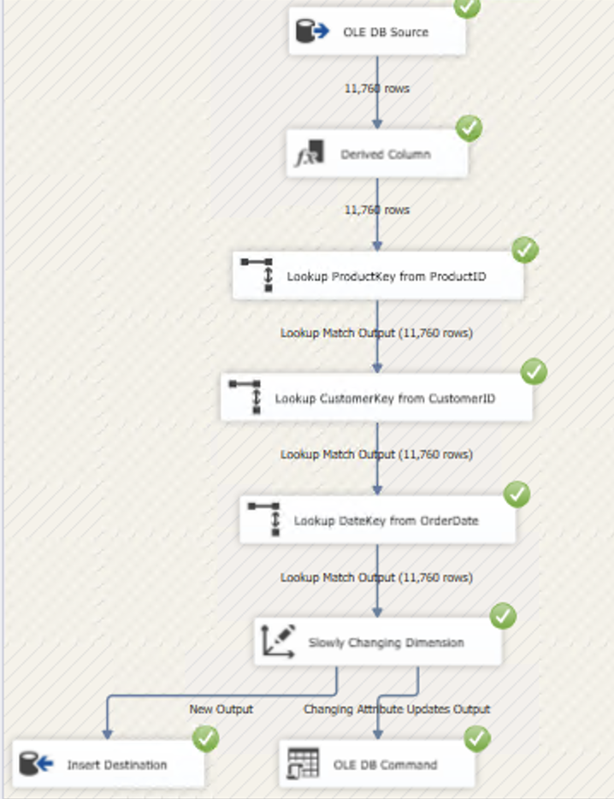
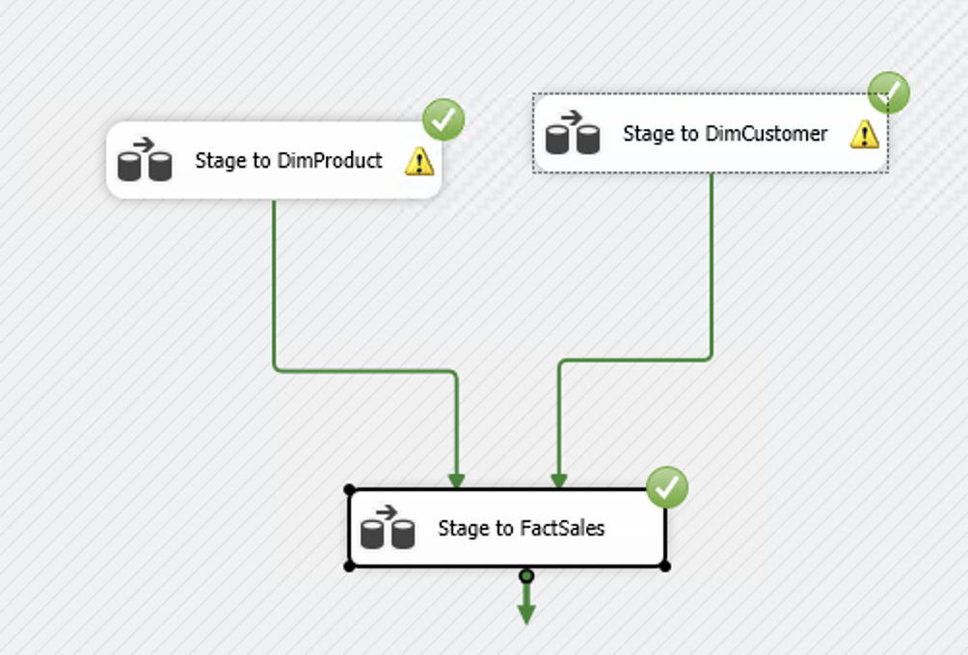
ETL - Stage to Data Warehouse
Since we merged the sales analysis business process, we only need one Fact Table.
Only
Notes:
Gabe

Slide 8
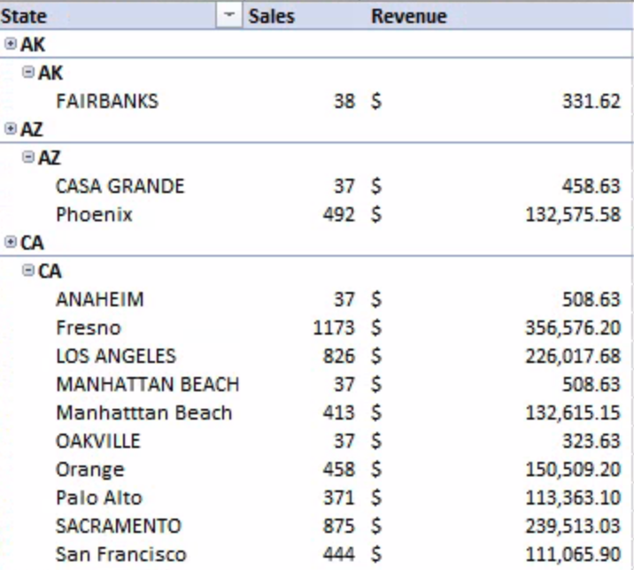
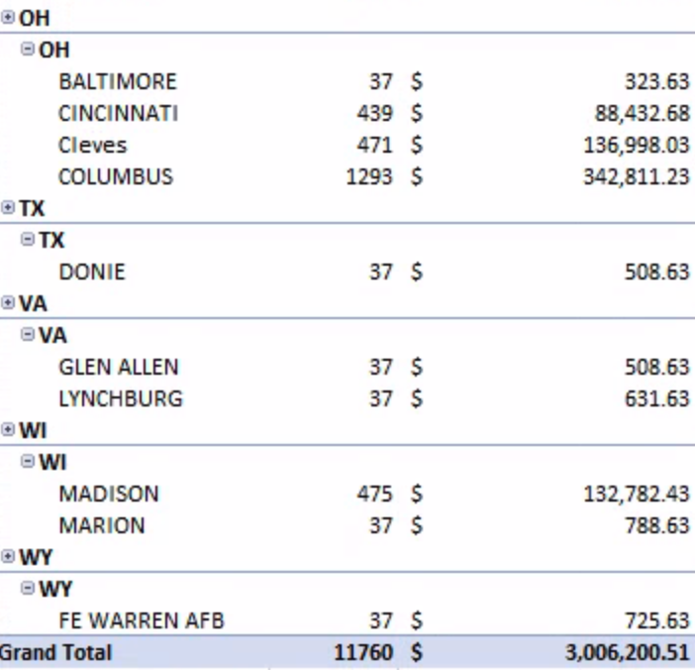
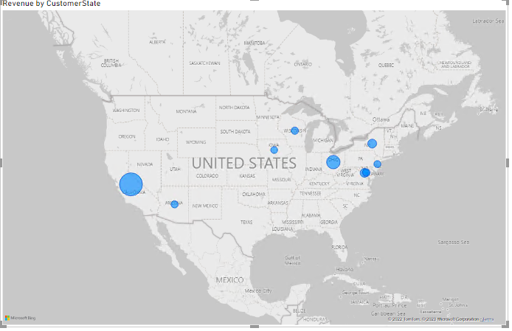
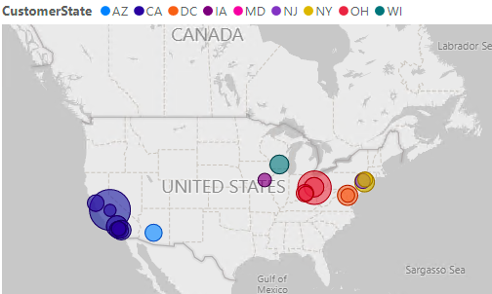
Insights/Trends
We created a Pivot Table in Excel which shows the sales and revenue by each state and city.
The city with the highest overall sales and revenue is Fresno, CA.

Slide 9
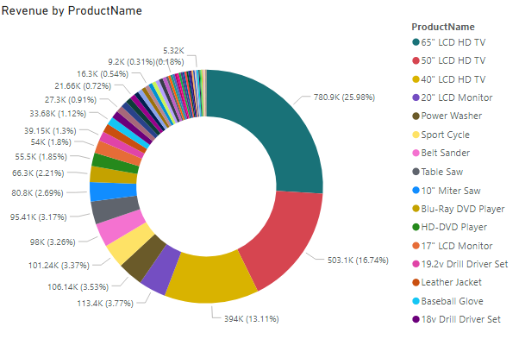
Insights/trends cont.
From our donut chart made in Power BI, we can see that the product with the highest revenue in the merged company is the 65” LCD HD TV.

Slide 10
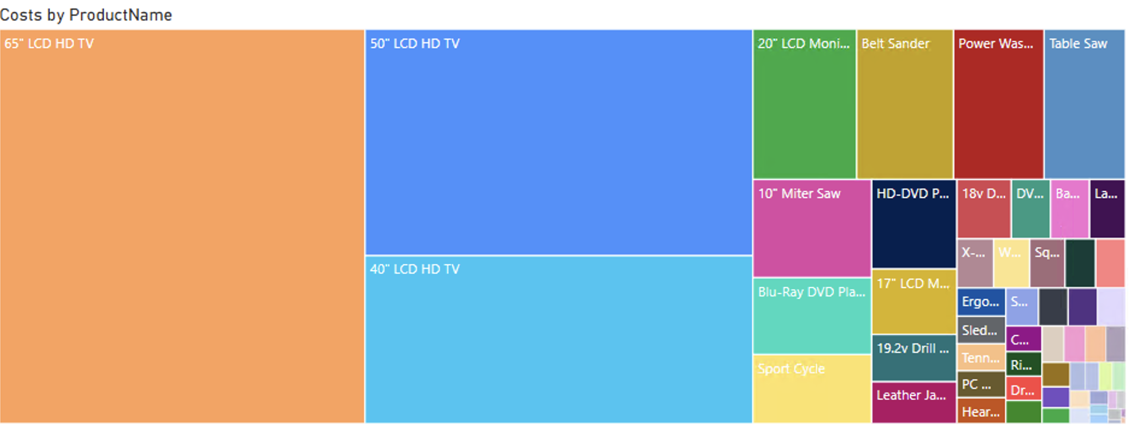
Insights/trends cont.
The top 10 products with the most revenue match up with the top 10 products with the highest costs

Slide 11
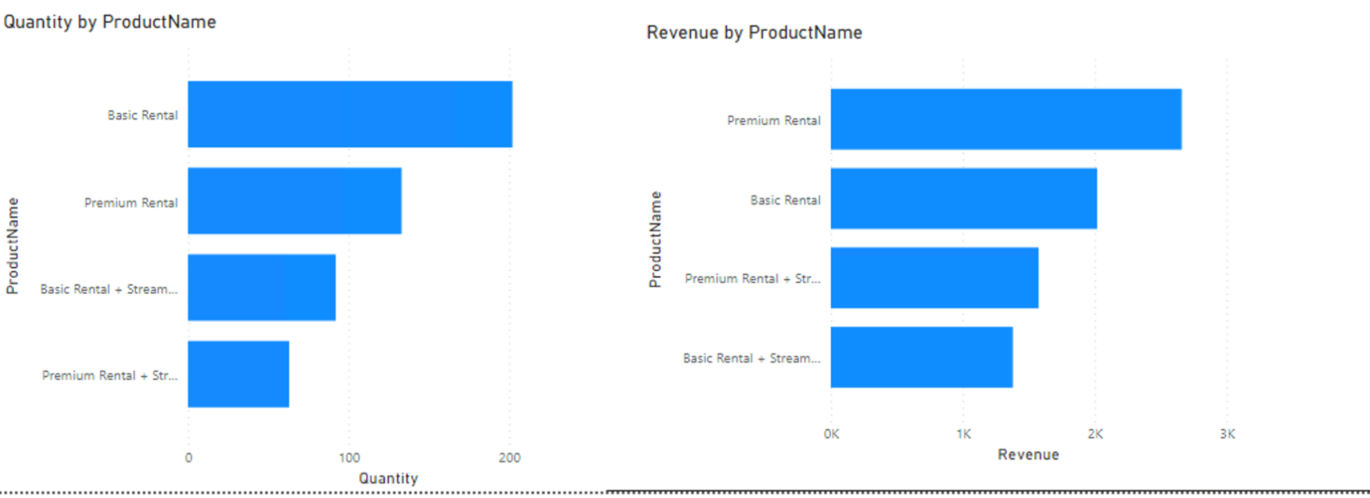
Insights/trends cont.
Compared to the FudgeMart products, the FudgeFlix subscription service does a fraction of the revenue.
We can see the two most popular choices are the Basic and Premium Rentals, which also generate the most money

Slide 12
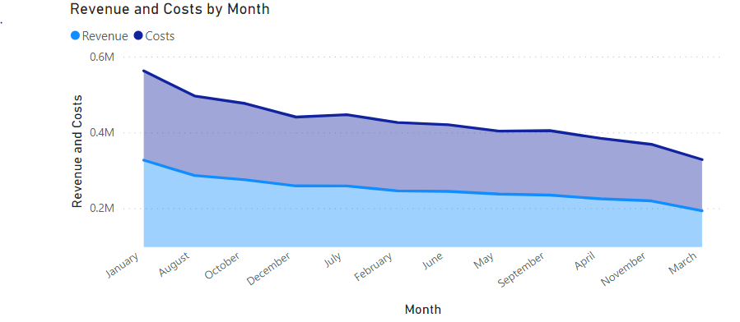
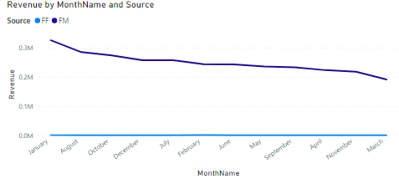
Insights/Trends cont.
The top chart illustrates revenue and costs by month. We can see that the the month with the highest revenue and cost was January and the month with the lowest revenue and cost was March.
Customer’s subscribe to FudgeFlix plans on every month evenly, so the change in monthly revenue largely depends on the FudgeMart product sales
Consider the factors impacting customer behavior such as holidays and season; we can tell that winter (Dec, Jan, Feb) have the highest sales.
Could be because the temperature makes customers want to shop online.
Notes:
Federal Holidays
New Year’s Day January 1
Martin Luther King’s Birthday 3rd Monday in January
Washington’s Birthday 3rd Monday in February
Memorial Day last Monday in May
Juneteenth National Independence Day June 19
Independence Day July 4
Labor Day 1st Monday in September
Columbus Day 2nd Monday in October
Veterans’ Day November 11
Thanksgiving Day 4th Thursday in November
Christmas Day December 25

Slide 13
Recommendations/ Nice to have data
It would have been useful to know how much it costs the company per subscription service that they sell, so we could accurately estimate the cost of operation and how much profit the FudgeFlix aspect of the business could make
The real money maker for the merged company is from the Fudge Mart products. Continue to buy revenue driving products (HD TV’s, Monitors) at wholesale prices and if they could buy more at a lower wholesale price it could be beneficial to their margins.
From the customer location research, we see that most of our customers are located in Fresno, CA., thus we suggest to check if we have a warehouse near there and make sure the supply chain works efficiently; Besides, the best sellers are TV, we have to make sure the transportation will not broke them.
From the sales /month research, we can see that people tends to online shopping in the winter time, thus we suggest put more advertisement before and during the Winter.
While the streaming service doesn’t generate as much revenue as the products, the assumed low costs allow for high profit margins on their subscription plans. They should continue to be sold. The plans with streaming built in are not as frequently bought, so this could be an area to market more or decrease the price.
Notes:
Data warehousing helps to incorporate data from various conflicting structures into a form that offers a clearer view of the enterprise.
Nice to have data:
Real time (efficient)
Improved decision-making

